Slide 1
Budget Form 3 Process POSITION CONTROL Department of Personnel Management
Presented By: Garrick Tsosie, HR Position Control Analyst

Slide 2
OVERVIEW
Introductions
Annual Budget Process - Upcoming Key Dates – Budgeting for Personnel
Budget Form 3 Process and Instructions
Questions

Slide 3
Position control section
The Position Control Section is responsible for entering and maintaining position and budget information in the Human Resources Information System (HRIS) – Position Control module.
Works closely with the Office of Management & Budget (OMB) during the Annual Budget Process regarding budgeting for Personnel
Generates Budget Form 3 for all General Fund programs
Enters and revises position and budget information
Completes Budget Upload in HRIS
Assigns New Position ID Numbers
Completes Budget Upload in HRIS
Prepares General Wage Adjustment (GWA) Projections for FY 2025
Prepares and Issues New Salary Schedules
Automates the Rollover of Employee Assignments
Automates the GWA for General Fund Employees

Slide 4
FY 2025 - annual budget process Upcoming Key Dates – Budgeting for Personnel
Dates | Key Events | Performed by
06/24/2024 | Budget Form 3 – Listing of Positions and Assignments generated and issued to the Divisions for dissemination to their respective programs. | DPM, Divisions
06/24/2024 – TBD | Budget Form 3 – Review, Verification and Revisions | Programs
TBD | Deadline to submit BF-3 for a finalized listing certified by DPM | Programs DPM

Slide 5
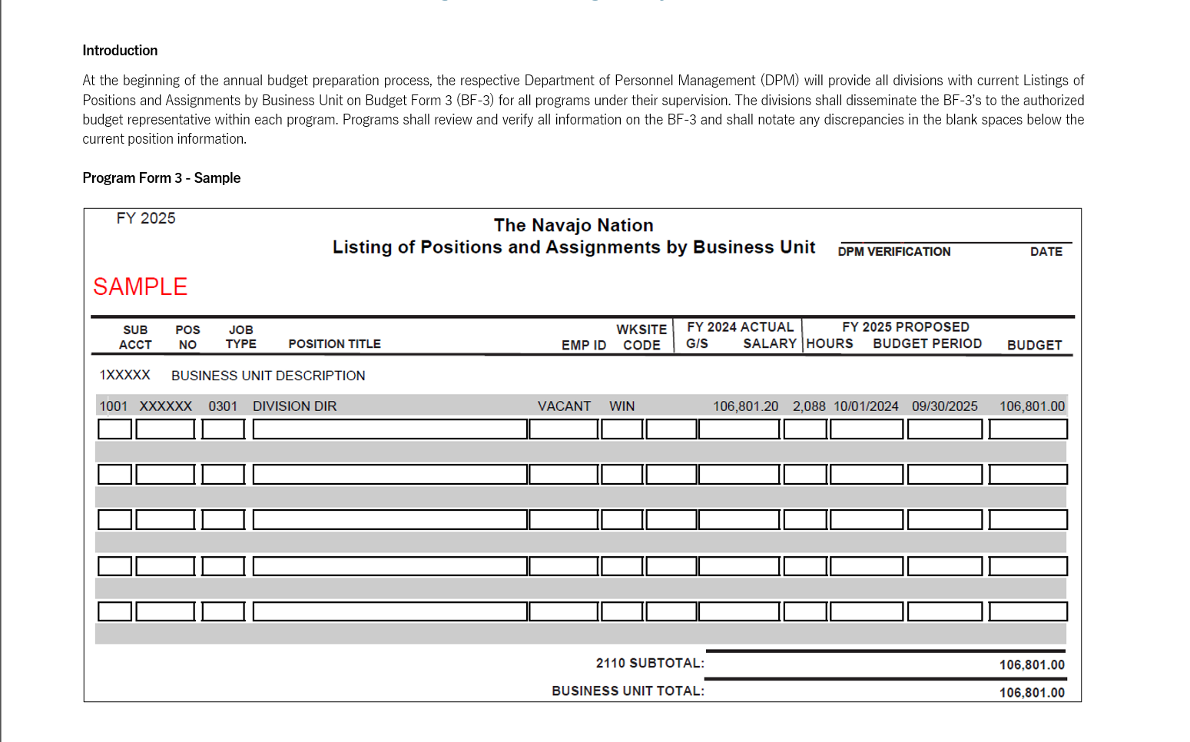

Slide 6
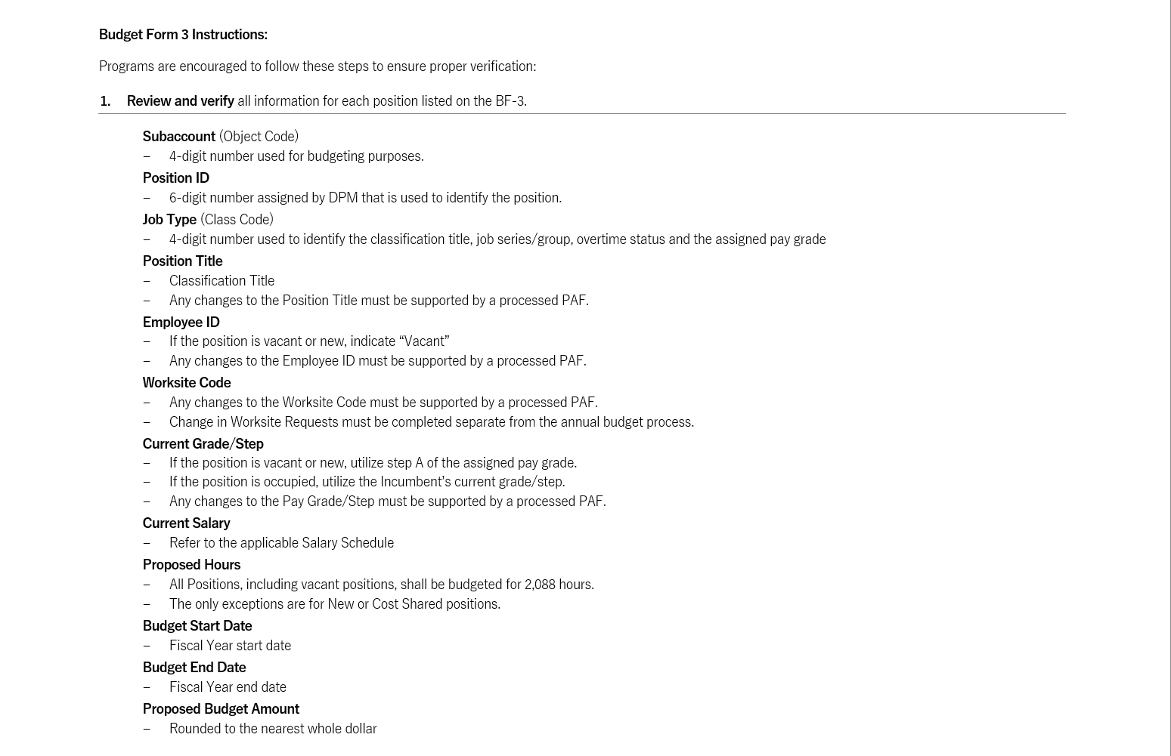

Slide 7
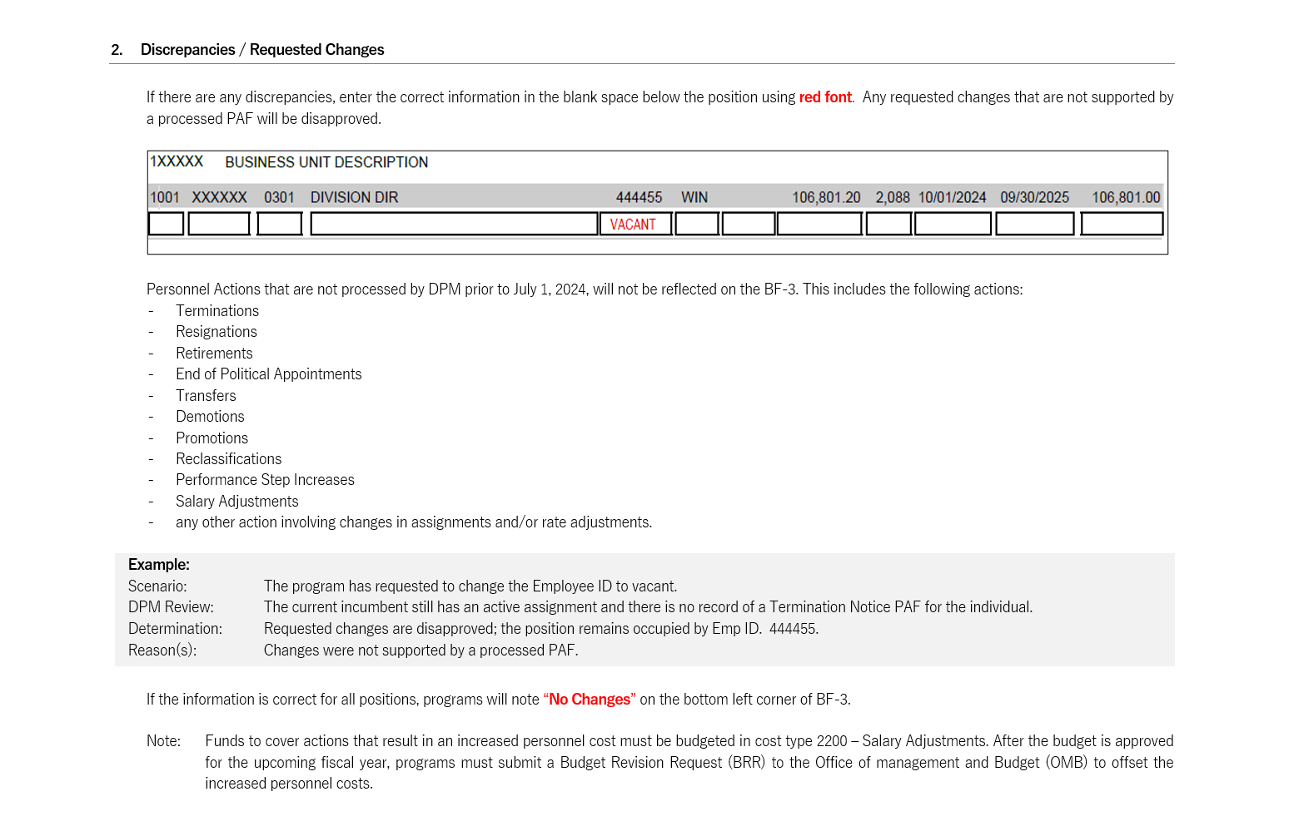

Slide 8
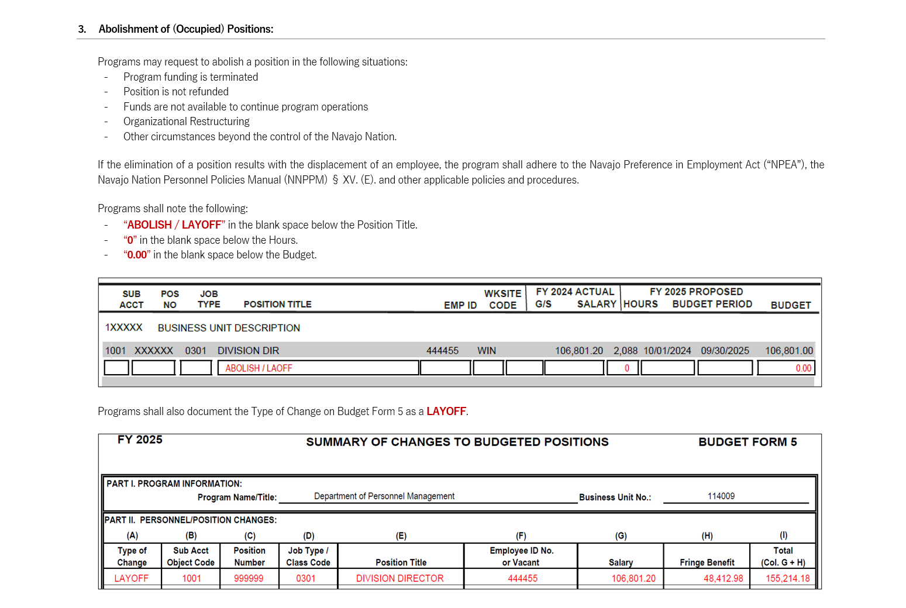

Slide 9
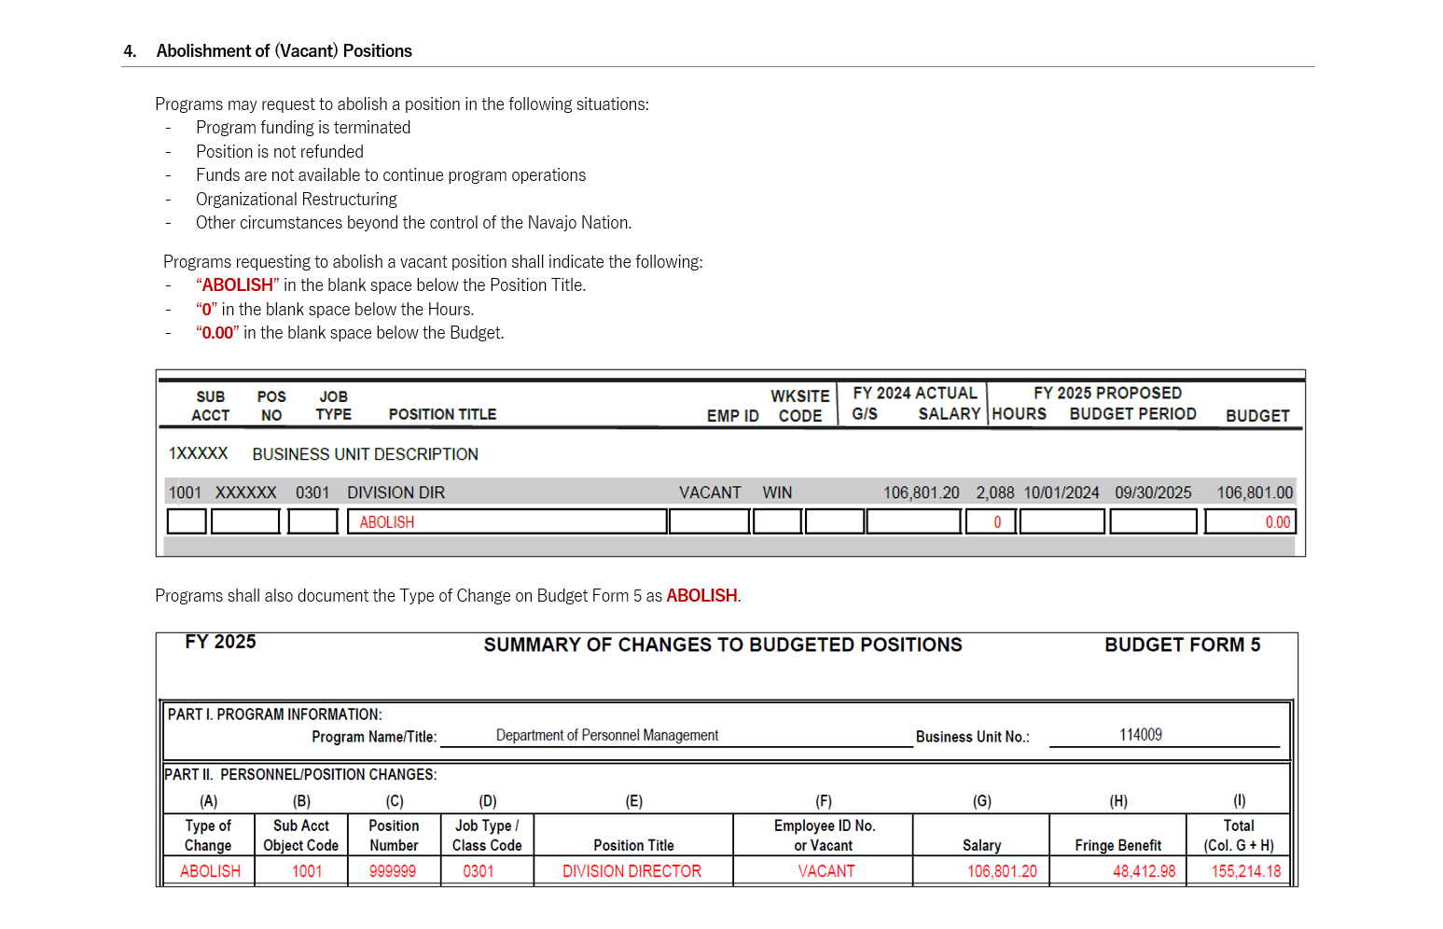

Slide 10
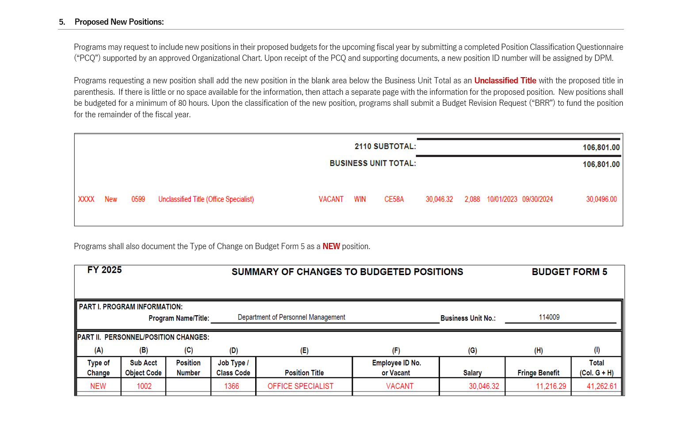

Slide 11
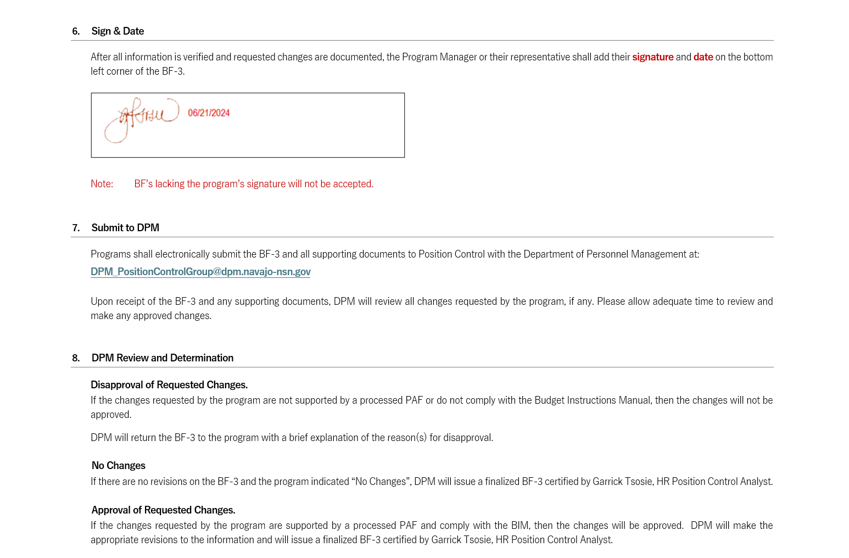

Slide 12
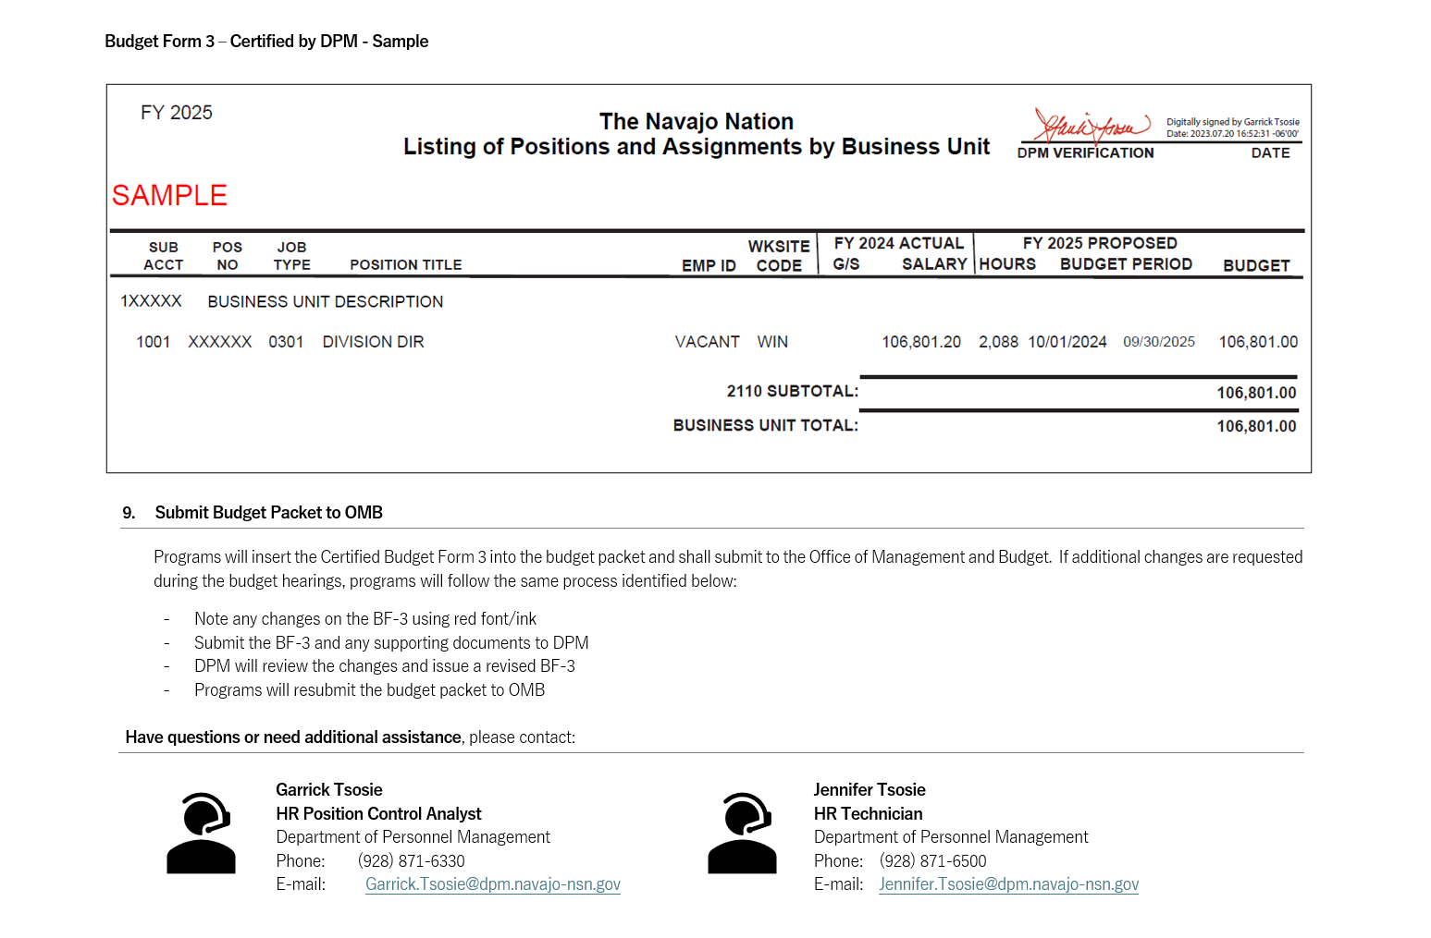

Slide 13
Questions Relating to budgeting for personnel?
Thank you for attending!

